Slide 1
Inpatient Prospective Payment System FY 2011
Hari Singhal, PhD

Slide 2
To rein in Medicare spending, it is important to optimize healthcare delivery for higher quality of service at lower cost
Medicare spending forms a significant proportion of congressional budget
There is significant variation among healthcare delivery in terms of quality of care to the patient per unit cost
For maximum impact on healthcare, it is important to tie recommendation for a provider to higher quality service and cost reduction
Significance: Efficient provider recommendation will optimize channeling of Medicare resources for higher quality patient care and cost reduction

Slide 3
Summary of the dataset. Assumptions and “Lack of Information”
Minimal IPPS data is provided to recommend provider based on the DRG code and hospital referral region
DRG payment factors include wage index, labor and non-labor rates, medical education costs (function of # residents and interns), disproportionate share payments (socioeconomic), cost outlier payments etc.
The task involves recommendation while “lack of these information”
Hypothesis: “Minimal” IPPS data can be explored to understand variances of healthcare delivery and to develop methodologies for cost reduction through optimal provider recommendation

Slide 4
There are variances in distribution of total discharges and average payments across states
DRG – Diagnosis related group; MDC – Major Disease Category

Slide 5
Sub-setting based on DRG/MDC informs that number of discharges for a specific DRG can significantly vary across states
DRG – Diagnosis related group; MDC – Major Disease Category

Slide 6
CA, FL, TX, NY, MA, IL, NJ and PA bill the most to Medicare

Slide 7
High variation and other considerations in number of providers per DRG alone, HRR alone or DRG+HRR
Most number of providers for SIMPLE PNEUMONIA & PLEURISY W CC
Not all 100 DRGs are present in every HRR
No. of providers for any given DRG and/or HRR significantly varies
Several DRG+HRR combinations have just one, or even, no choice for a provider

Slide 8
Certain DRG procedures have much higher number of discharges
All Providers
470 - MAJOR JOINT REPLACEMENT OR REATTACHMENT OF LOWER EXTREMITY W/O MCC
871 - SEPTICEMIA OR SEVERE SEPSIS W/O MV 96+ HOURS W MCC
392 - ESOPHAGITIS, GASTROENT & MISC DIGEST DISORDERS W/O MCC
Individual provider
HOSPITAL FOR SPECIAL SURGERY, NY, ID 10021
470 - MAJOR JOINT REPLACEMENT OR REATTACHMENT OF LOWER EXTREMITY W/O MCC

Slide 9
There is almost a 3-4 orders of difference between the number of discharges among the providers
………………………….

Slide 10
Relatively lower variation in the paid-to-charged ratio among DRG procedures
Proportion paid to the providers is quite similar across DRGs
470
871
Major joint replacement and Septicemia are two most charged as well paid procedures
These two procedures have the maximum number of discharges as well

Slide 11
There are patterns in the costs and discharges associated with DRGs
Huge variations in the prices across DRG codes – could possibly be related to the complexity of the DRG process
Total number of discharges is positively correlated to the price of DRG!
Relatively lower variations in paid-to-charged ratios
All DRGs

Slide 12
There are patterns in the costs associated with DRGs
Huge variations in the prices across DRG codes – could possibly be related to the complexity of the DRG process
Total number of discharges is positively correlated to the price of DRG!
Relatively lower variations in paid-to-charged ratios even on this extended contrast.
Top (and bottom) 20 highest (and lowest) charged DRGs

Slide 13
There is a wide variation in the paid-to-charged ratio among providers
Top 20 highest-charging providers
Cedars-Sinai is 2nd highest-charging provider, but with relatively lower discharges – it possibly does higher-end, expensive procedures.
NY-Presbytarian’s paid-to-charged ratio is almost 4.5 times higher than Crozer Chester Medical Center

Slide 14
There is a wide variation in total charges, total paid, total discharges and paid-to-charged ratios among providers
At least three clusters of providers emerge
Higher prices and discharges – lower paid-to-charged ratios
Lower prices and discharges – higher paid-to-charged ratios
Intermediate of the above two
Significant variation in prices, total number of discharges and paid-to-charged ratios
All providers

Slide 15
There is a wide variation in total charges, total paid, total discharges and paid-to-charged ratios among providers
Top (and bottom) 50 highest (and lowest) charging providers

Slide 16
Wide variation in the paid-to-charged ratio among providers is also observed for individual DRGs
DRG#470 (Major joint replacement)
Top (and bottom) 10 highest (lowest) charging providers
DRG 470: Chicksaw Nation Medical Center has been paid almost 300% of their charged price, whereas Pottstown Memorial Medical Center has had a mere 6.3% of their charges paid
DRG payment factors: Wage index, Medical education costs, disproportionate share payments, cost outlier payment

Slide 17
Wide variation in the paid-to-charged ratio among providers is also observed for individual DRGs
DRG#470 (Major joint replacement)
Bigger variations in Z scores for DRG 470 as compared to when all DRGs are analyzed
Indicating that the spread of variations could be different for different DRGs
At least three clusters of providers emerge
Higher prices and discharges – lower paid-to-charged ratios
Lower prices and discharges – higher paid-to-charged ratios
Intermediate of the above two
Significant variation in prices, total number of discharges and paid-to-charged ratios
All providers, DRG 470

Slide 18
Additional information that may potentially help in developing the recommendation engine
Quality of care by the provider
Rating of the provider by patients and/or employees
Prior Patient experiences/reviews
Success rate of DRG procedures/Complications (adverse) events
Failures and complications of DRG procedures
Ability of the provider to handle other DRG procedures belonging to the same Major Disease Category
Characteristics of the patient
Presence/absence of other co-morbidities
Clinical complexity of the DRG procedure
Demographics of the patient
Personal considerations/choices

Slide 19
Grouping DRGs into Major Disease Category and taking similar expertise into account
Diseases of circulatory, respiratory and muscoskeleton systems are most charged as well as paid
Mental, alcohol, addiction and systemic infectious diseases have highest paid-to-charge ratios
Downloaded MDC codes from internet
Notes:
|MDC_desc | total_charges| total_paid| ratio_paid_charged|
|:----------------------------------------------------------------------------------------|-------------:|-----------:|------------------:|
|Diseases and Disorders of the Circulatory System | 66318810645| 14833354509| 0.2236674|
|Diseases and Disorders of the Respiratory System | 39950484133| 9452585498| 0.2366075|
|Diseases and Disorders of the Musculoskeletal System And Connective Tissue | 39443568701| 9446951020| 0.2395055|
|Infectious and Parasitic DDs (Systemic or unspecified sites) | 28253791161| 7282586942| 0.2577561|
|Diseases and Disorders of the Digestive System | 24944991412| 5853650061| 0.2346623|
|Diseases and Disorders of the Kidney And Urinary Tract | 15882424192| 3898393060| 0.2454533|
|Diseases and Disorders of the Nervous System | 12833474329| 2785525909| 0.2170516|
|Diseases and Disorders of the Endocrine, Nutritional And Metabolic System | 5431883678| 1274421904| 0.2346188|
|Diseases and Disorders of the Skin, Subcutaneous Tissue And Breast | 3528933898| 835017307| 0.2366203|
|Diseases and Disorders of the Blood and Blood Forming Organs and Immunological Disorders | 2766554950| 649090377| 0.2346205|
|Diseases and Disorders of the Hepatobiliary System And Pancreas | 1920986737| 394891473| 0.2055670|
|Mental Diseases and Disorders | 1683487090| 559586989| 0.3323976|
|Injuries, Poison And Toxic Effect of Drugs | 1171613434| 269040672| 0.2296326|
|Factors Influencing Health Status and Other Contacts with Health Services | 944695299| 202885830| 0.2147632|
|Alcohol/Drug Use or Induced Mental Disorders | 459327188| 134343525| 0.2924789|
|Diseases and Disorders of the Ear, Nose, Mouth And Throat | 442854702| 82094661| 0.1853761|

Slide 20
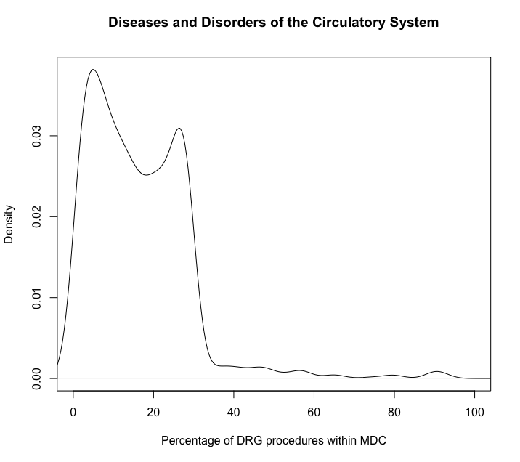
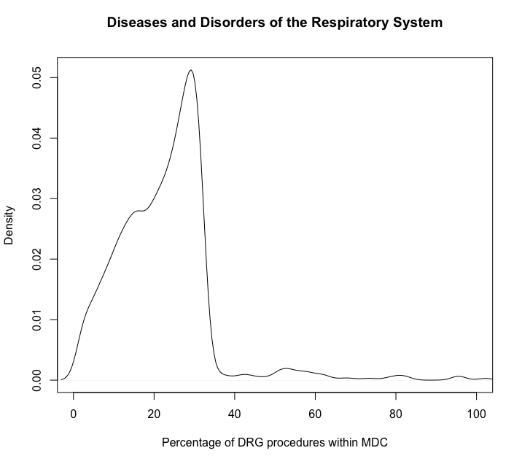
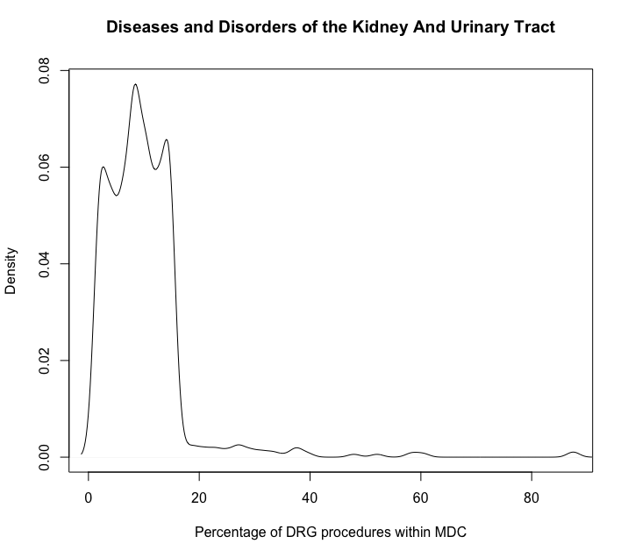
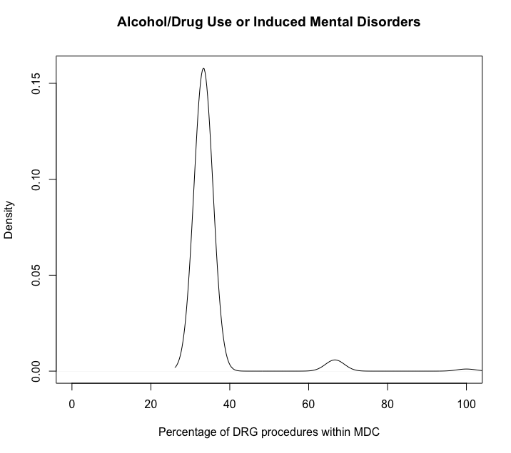
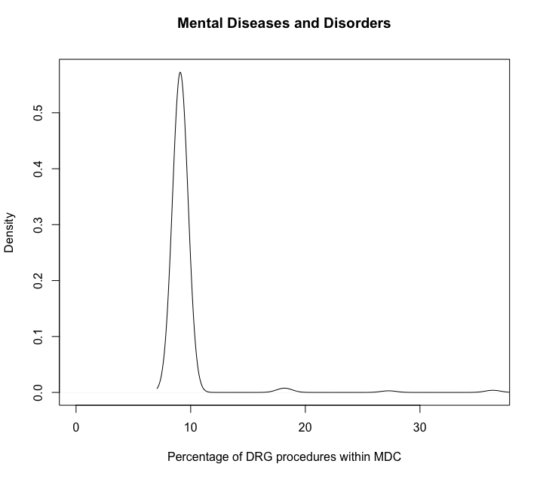
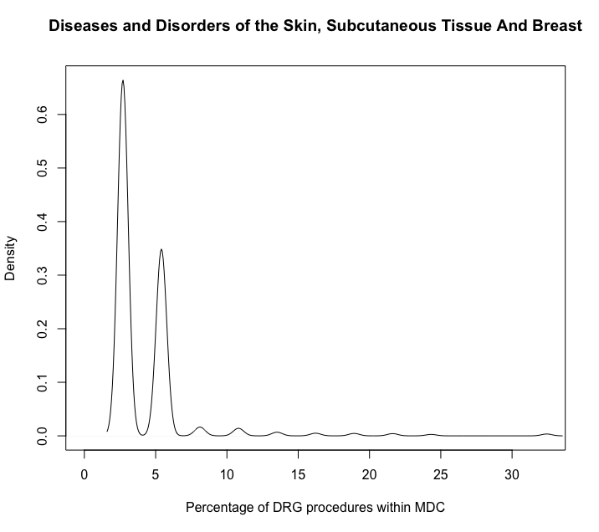
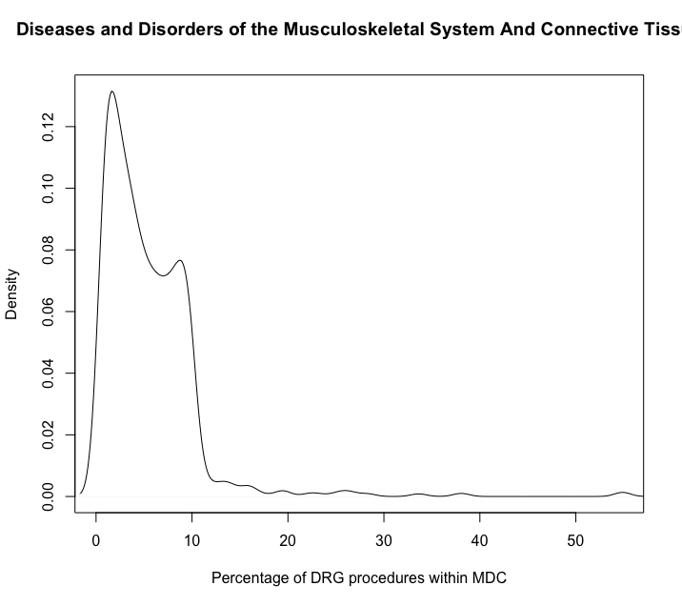
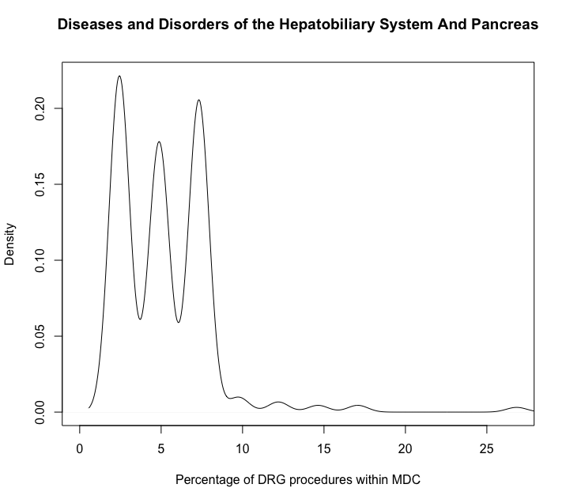
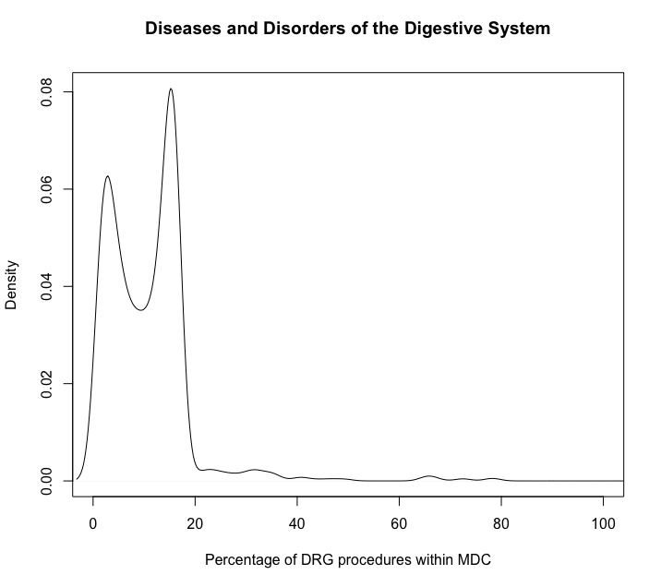
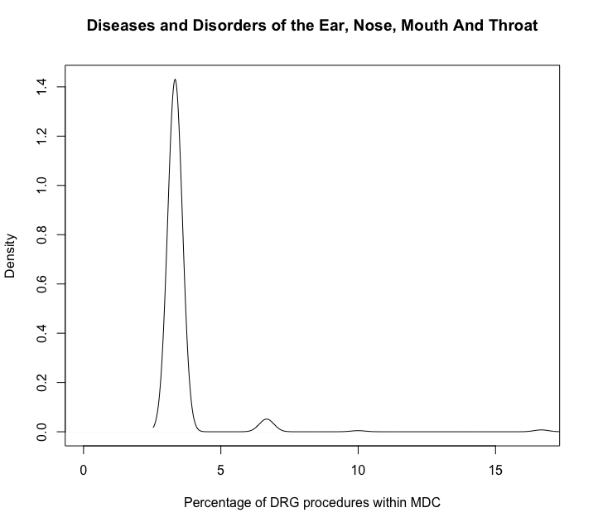
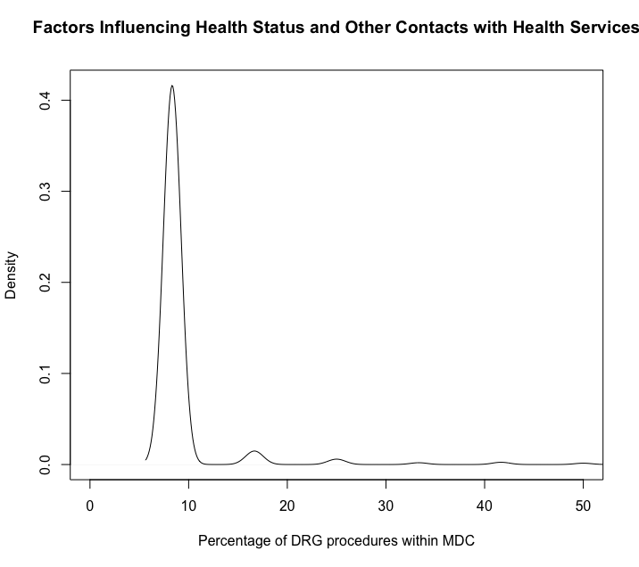
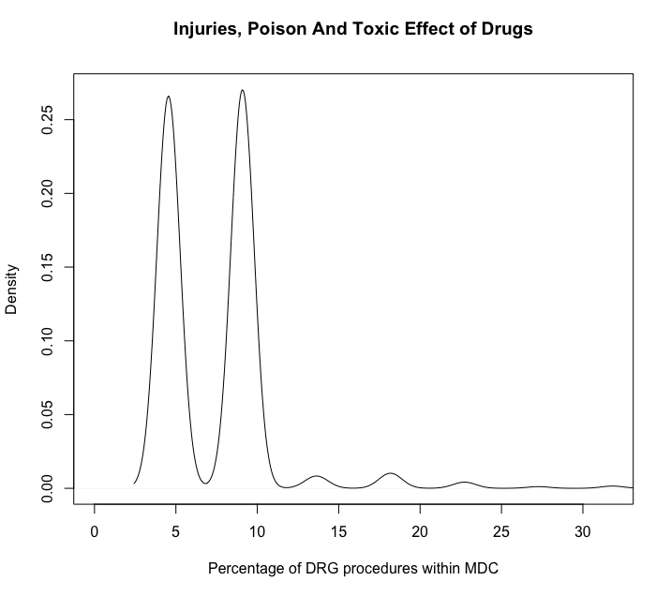
Providers that serve multiple DRGs which map to same Major Disease Category are likely to be a “hub/expert facility” for that particular disease category
MDC score
MDC (i) = no. of DRGs at a provider in MDC(i)*100 Total DRGs in MDC(i)

Slide 21
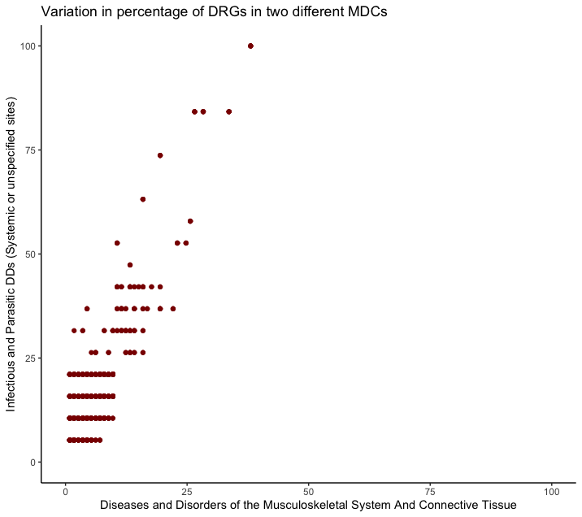
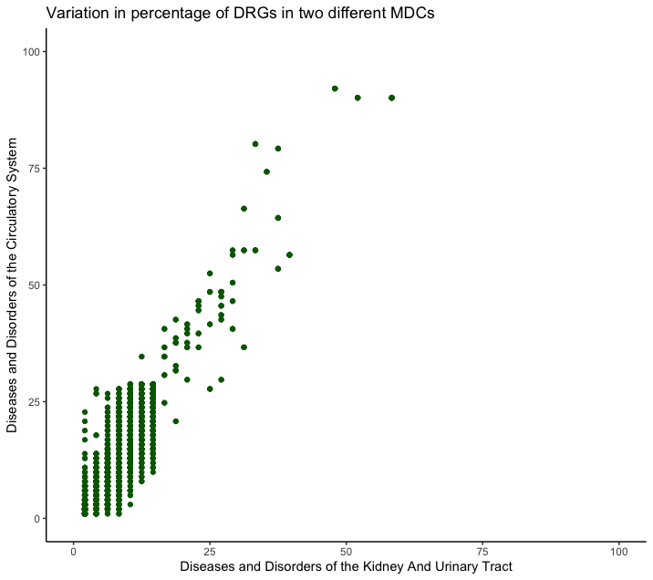
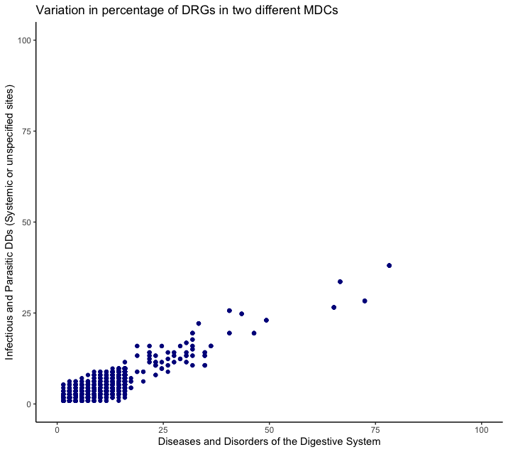
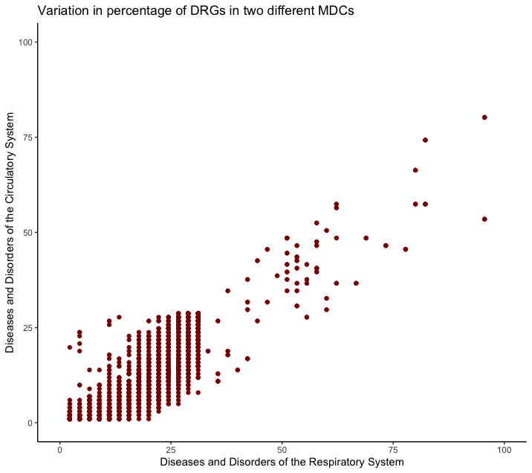
Providers have variances in “relative expertise” among different combinations of medical diseases
MDC4: Respiratory MDC11: Kidney and urinary tract
MDC18: Muskoskeleton MDC6: Digestive system
Presence/absence of other co-morbidities and the ”expertise” of the provider in those co-morbidities could be informative

Slide 22
Proposed features and features engineering
Accounting when not enough providers for a DRG and HRR combination
Expand the geographical radius of the HRR under consideration till there are a predefined number of providers with the requested DRGs
Geographical radius may be a function of patient preferences, disease characteristics etc.
Consider how expansion effects mix of urban and rural facilities, and/or facilities teaching, and caring for different socioeconomic groups
Engineering features after the pre-defined number of providers have been identified
Log normalization of some of these variables.
Z scores for prices (all three prices, paid-to-charge ratios) and total discharges. Z scores for MDC scores
Cluster number from unsupervised clustering of providers
Variation among providers for a particular DRG
Negative reinforcement of recommendation for providers that would be ”over capacity”
Hospital labor and non-labor rates, teaching or non-teaching provider, Type of DRG
Provider performance

Slide 23
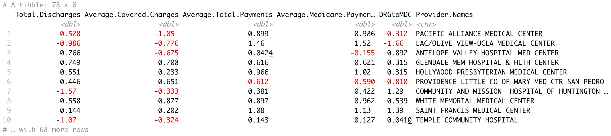
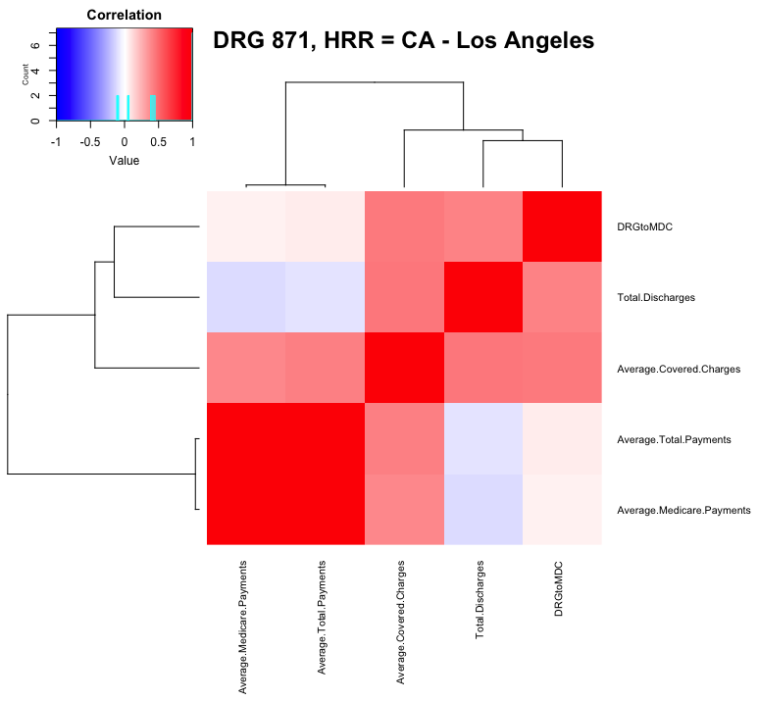
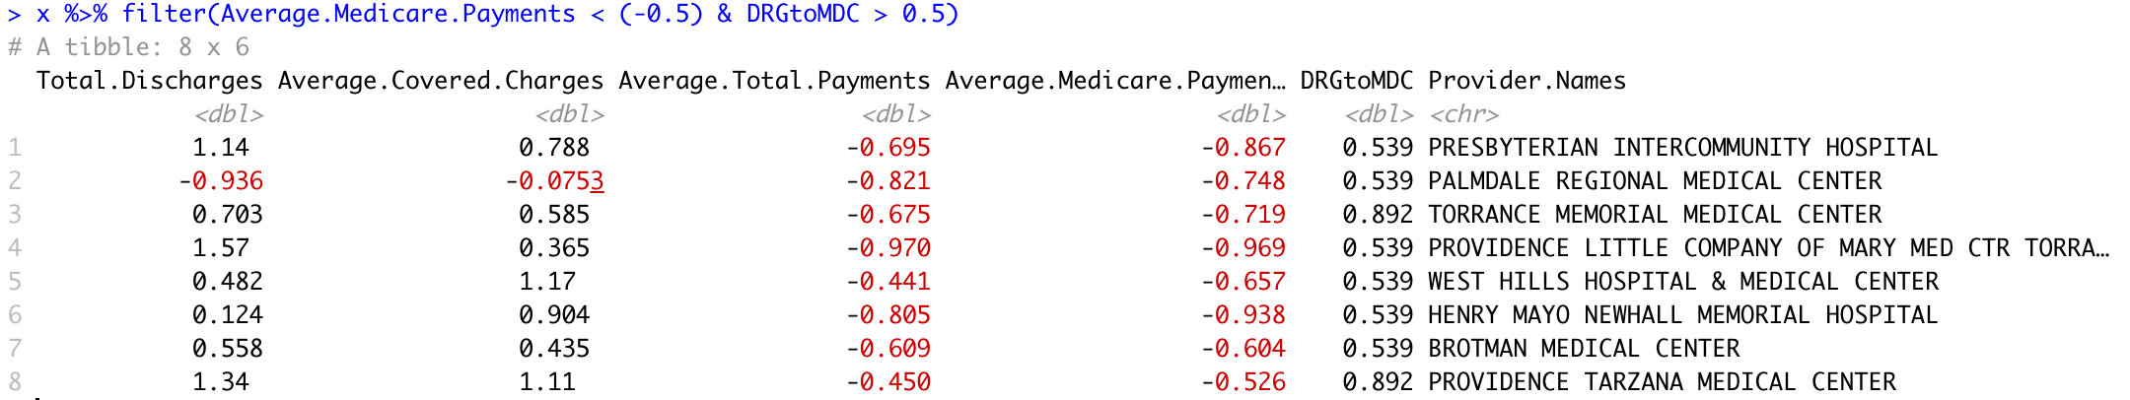
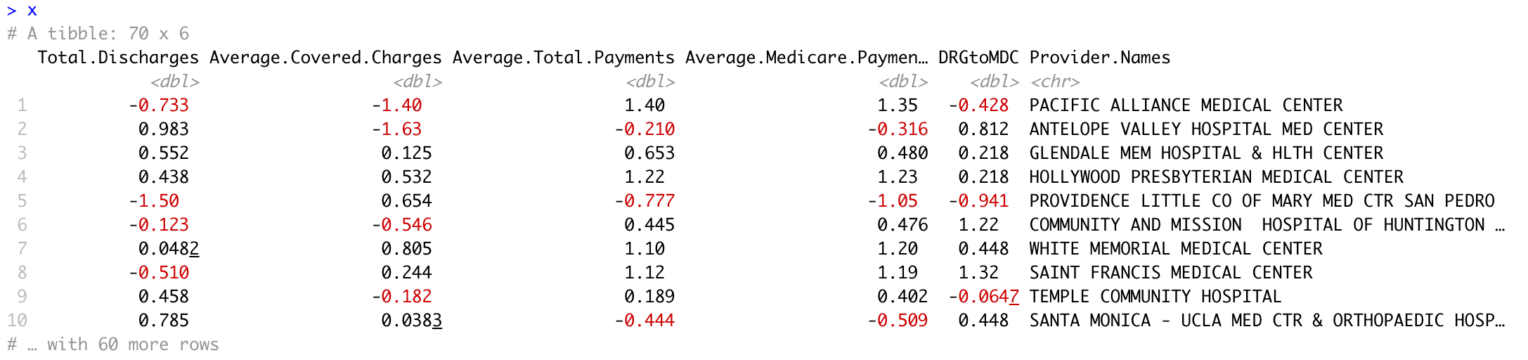
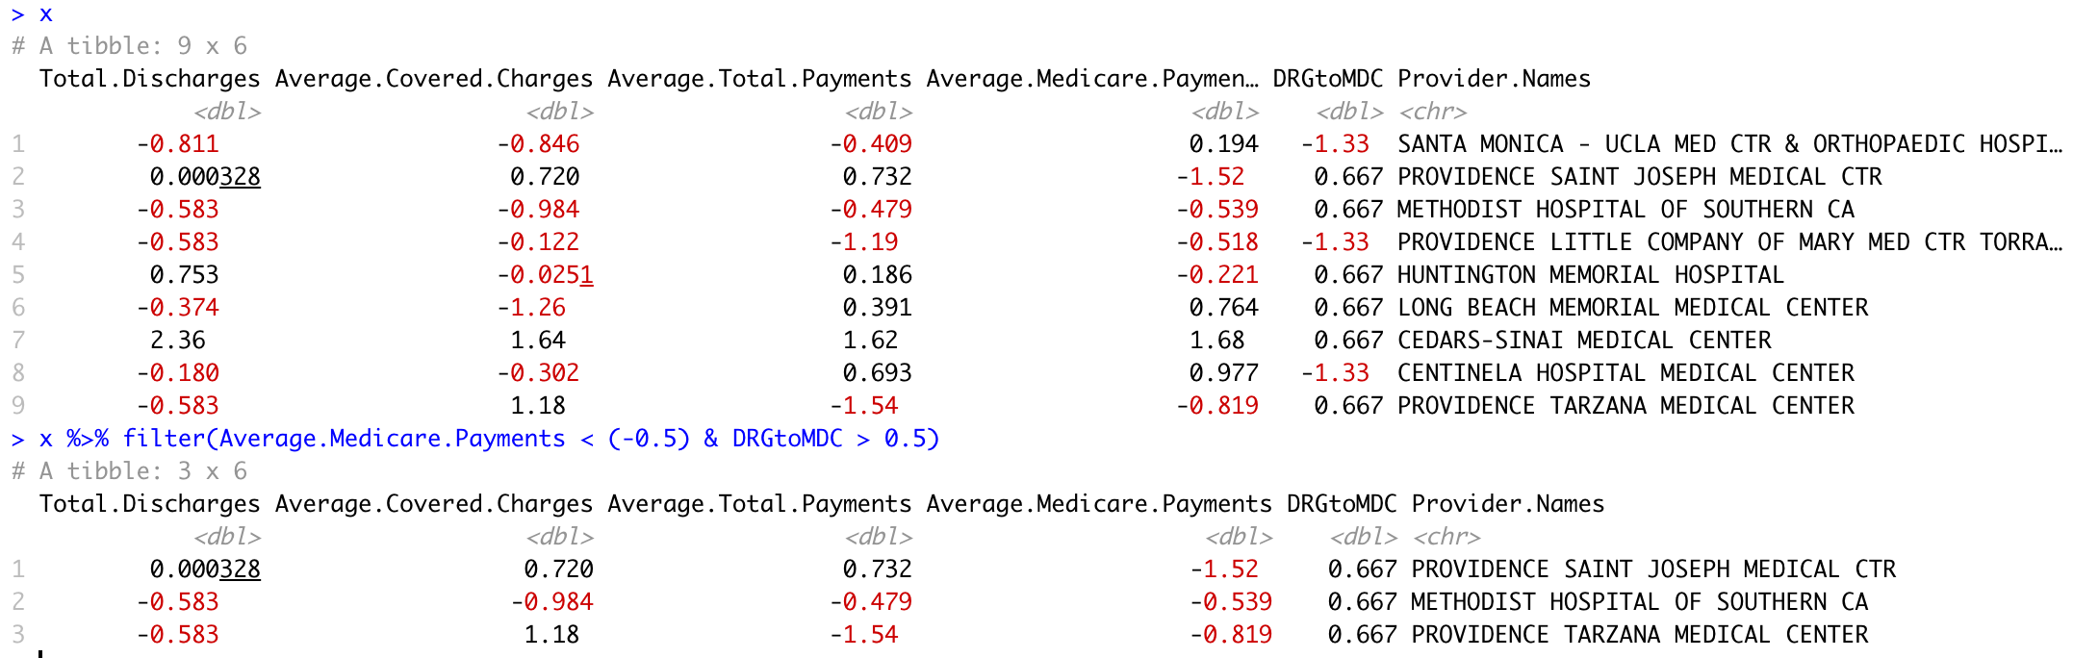
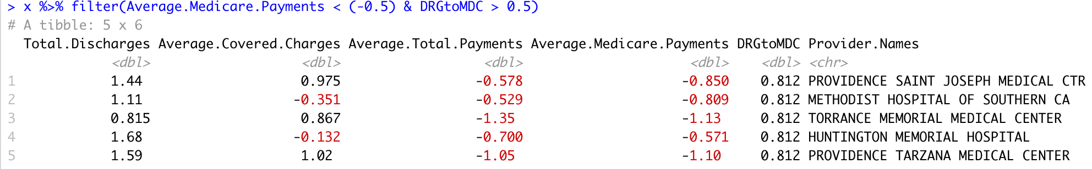
Proposed features and features engineering – example, CA – LA, DRGs 871, 392, 301
DRG 871: Septicemia
Currently limited feature space due to time constraints. Feature space can be expanded.
DRG 392: Esophagitis
DRG 392: Peripheral Vascular

Slide 24
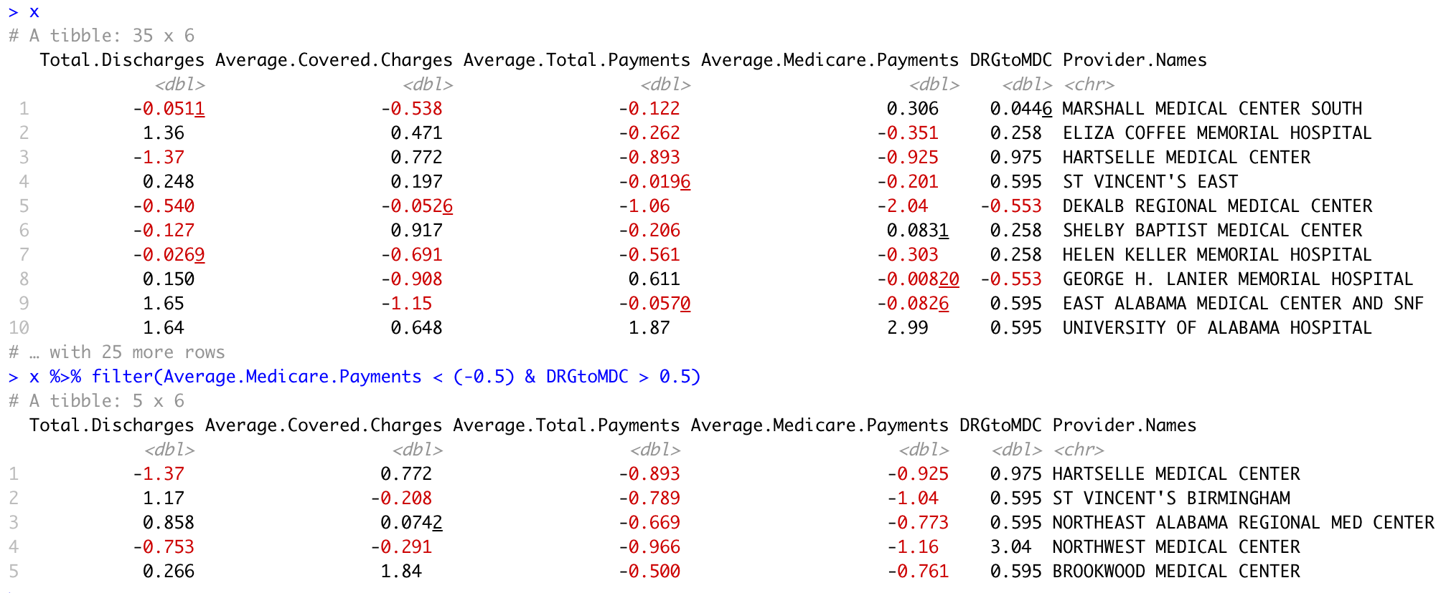
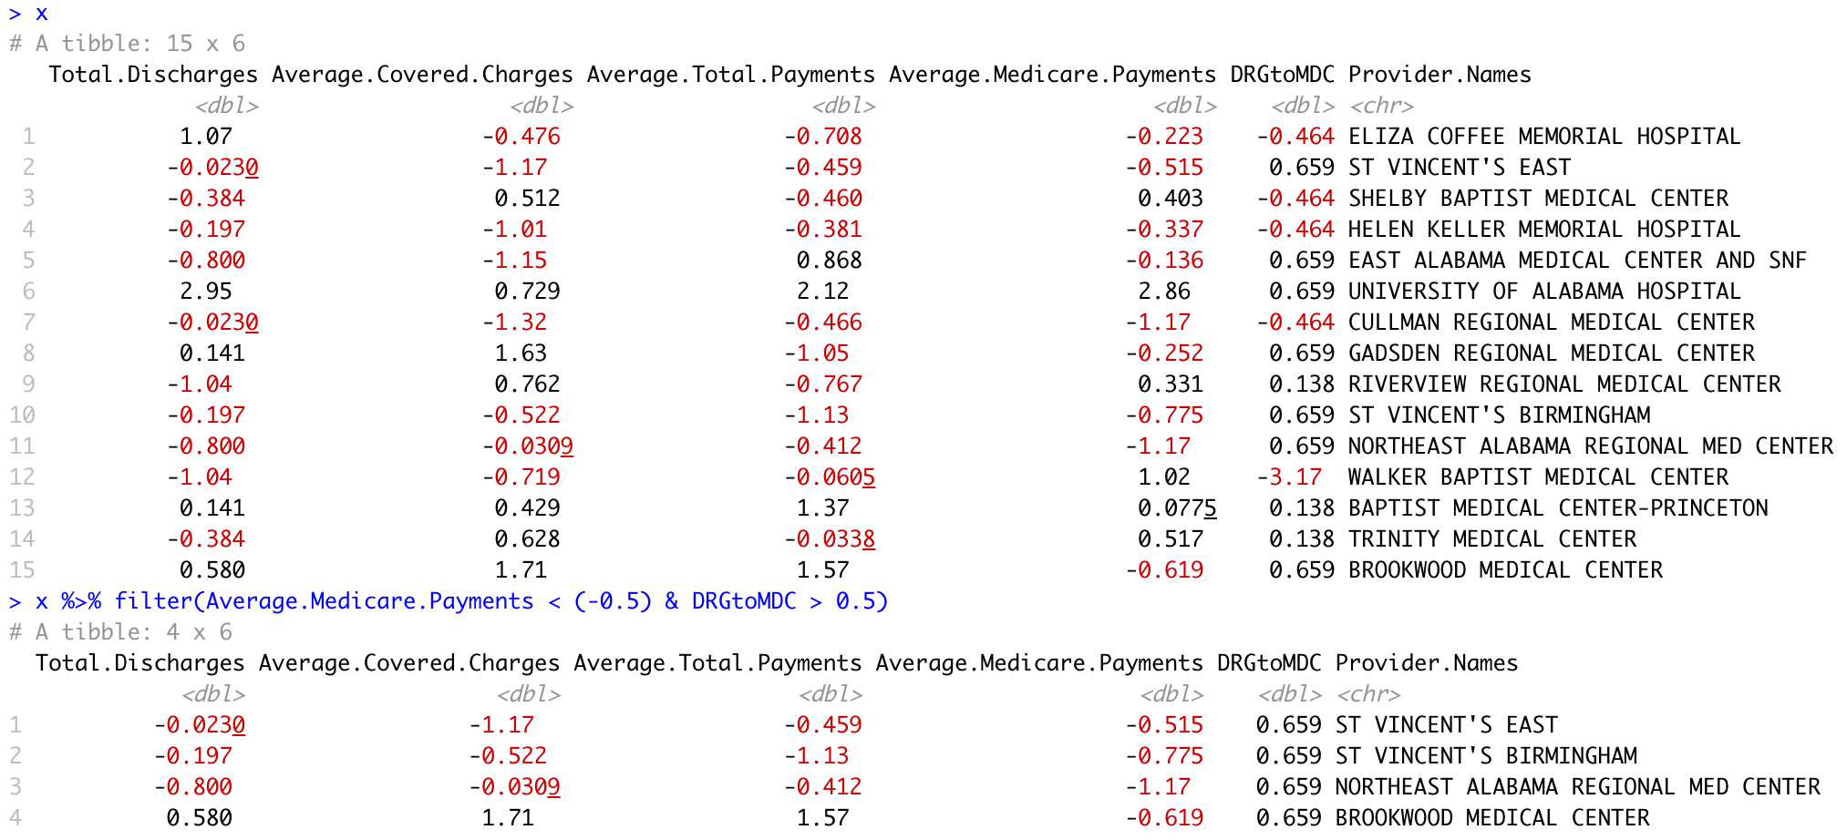
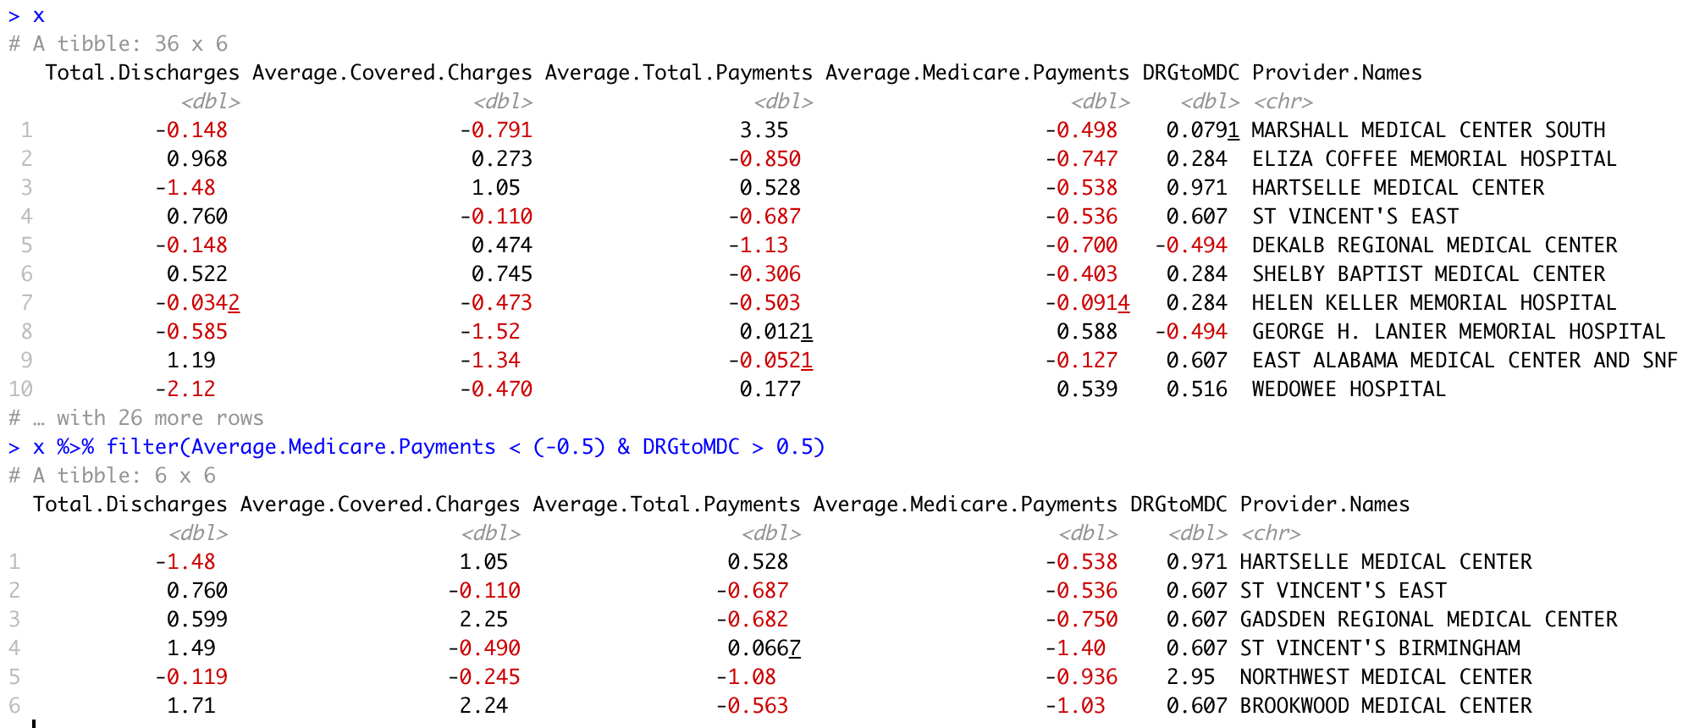
Proposed features and features engineering – AL - Birmingham, DRGs 871, 392, 301
Currently limited feature space due to time constraints. Feature space can be expanded.
DRG 871: Septicemia
DRG 392: Peripheral Vascular
DRG 392: Esophagitis

Slide 25
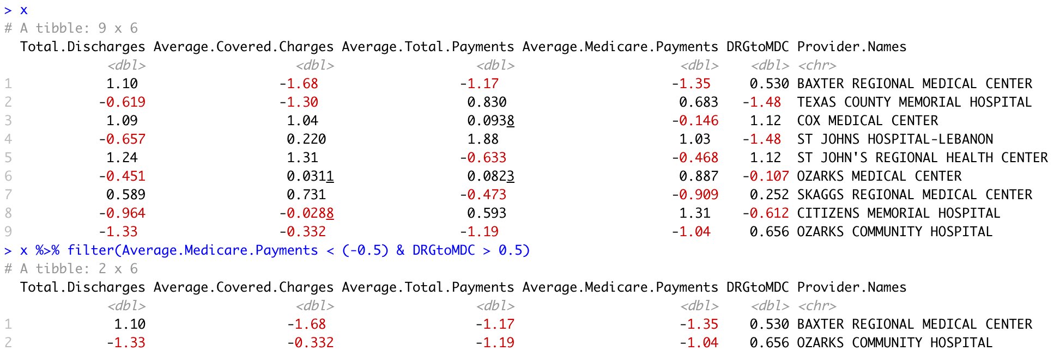
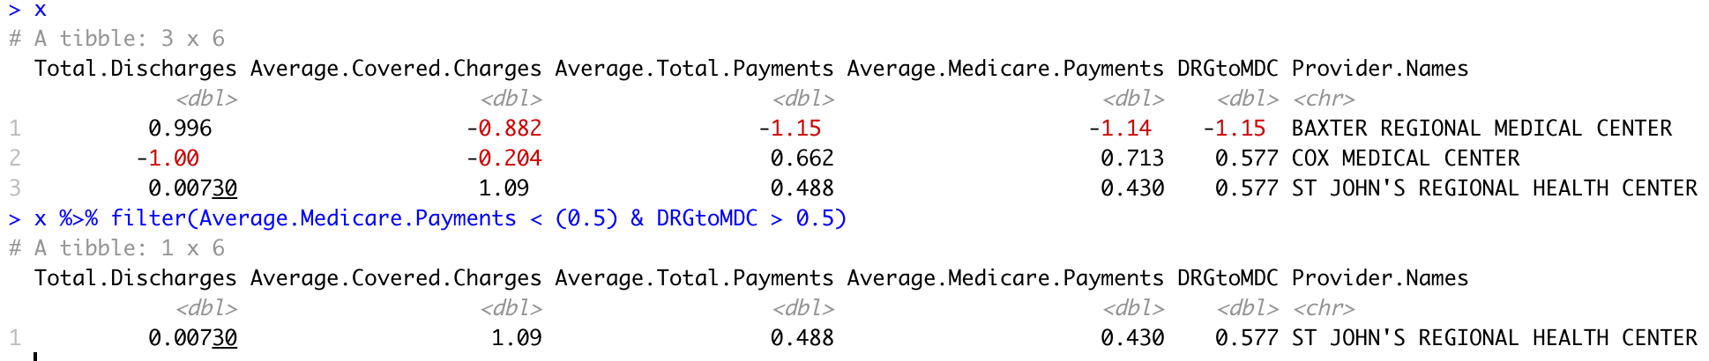
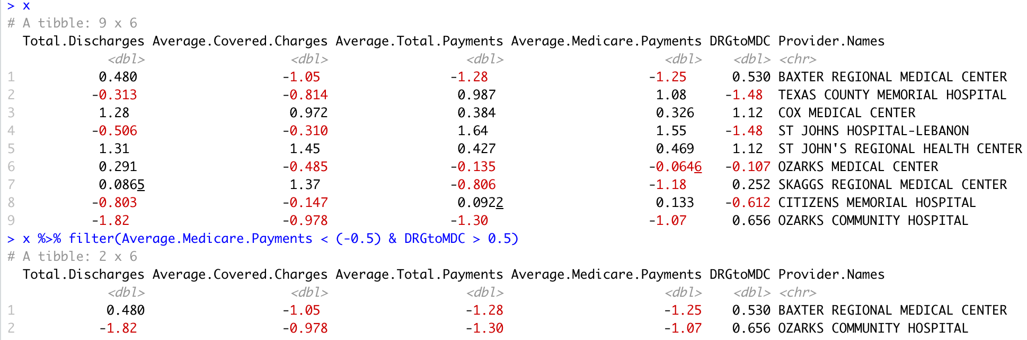
Proposed features and features engineering – MO - Springfields, DRGs 871, 392, 301
Currently limited feature space due to time constraints. Feature space can be expanded.
DRG 871: Septicemia
DRG 392: Peripheral Vascular
DRG 392: Esophagitis

Slide 26
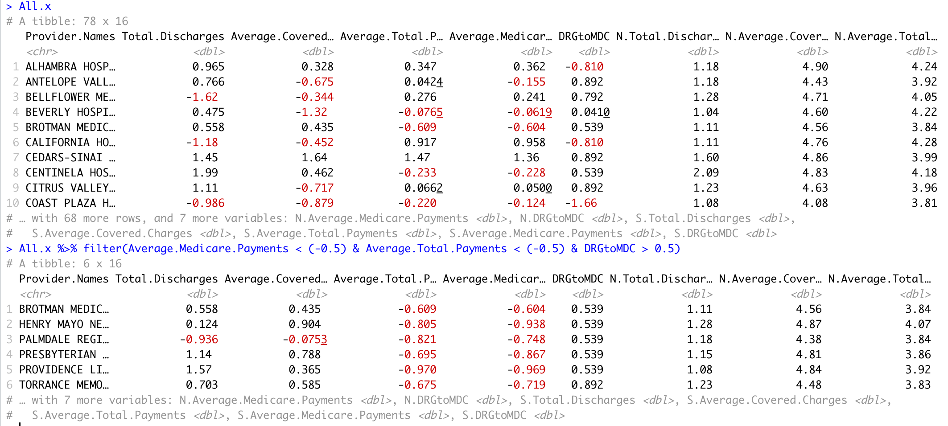
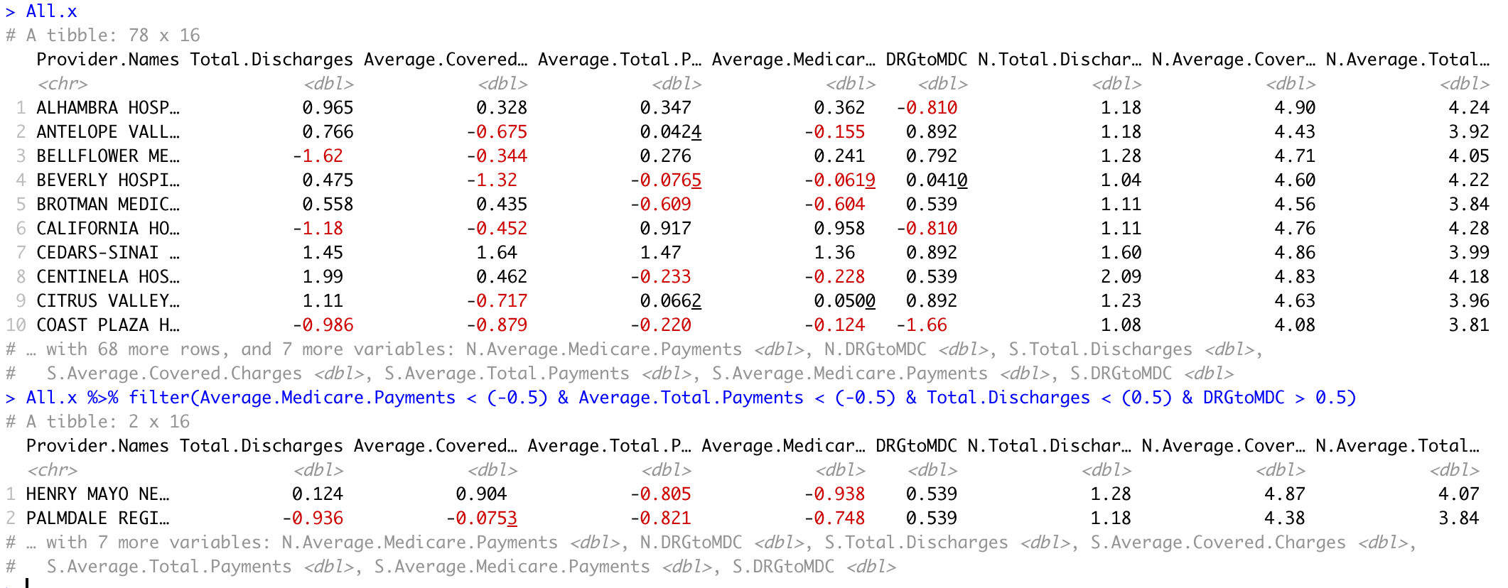
Inclusion of additional features, state and nation-wide comparisons
DRG 871: Septicemia
Unlike Total payments and medicare payments, Covered charges from HRR cluster separately from the ones determined at State and National level – Indicating wide variations in covered charges across providers
Bringing in nation and state-wide comparisons could possibly add limited new information
Addition of Total Payments helps further narrow the selection
Addition of Total Payments and Total Discharges

Slide 27
Future directions. Potential applications of the idea.
Incorporate more features (Hospital labor and non-labor rates, teaching or non-teaching provider, Type of DRG, Variation among providers for a particular DRG, Provider performance )
Perform features engineering with the expanded features space
Access hospital labor and non-labor rates and other data to model various coefficients (Wage index, Medical education costs, disproportionate share payments, cost outlier payment)
Optimize the cutoffs for selecting a provider within HRR
Study the characteristics of providers with HRR or “expanded HRR”
Applications
Can be used by Medicare to study inefficiencies in pricing and for streamlining resource allocation
May be used as a engine for recommending providers at point-of-care

